Slide 1

Conditions & Loops

Slide 2
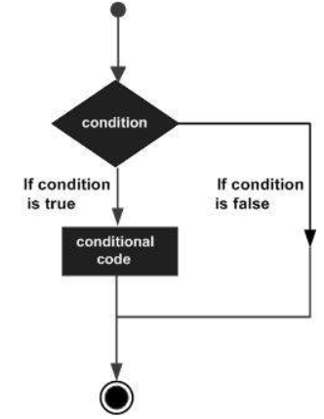
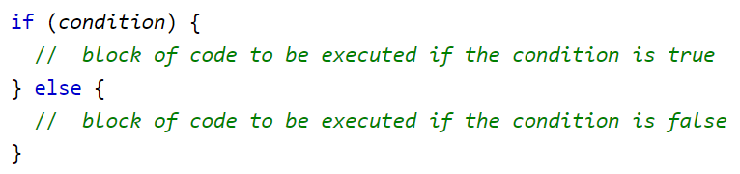
Types of Conditional Statements
“Else” Statement
“Else” Statement is used when a specific block of code to be executed, If a condition is false.
How “Else” Statement works:
If the condition is true,then the code inside the if block will be executed.
If the condition is false, then the code inside the else block will be executed.
Syntax
JS Conditional Statements
Types of Conditional Statements
‘Switch’ Statement
Notes:
explain about the Else statement with help of the code: https://replit.com/@FathimaU/Ifelsecondition?v=1#index.html

Slide 3
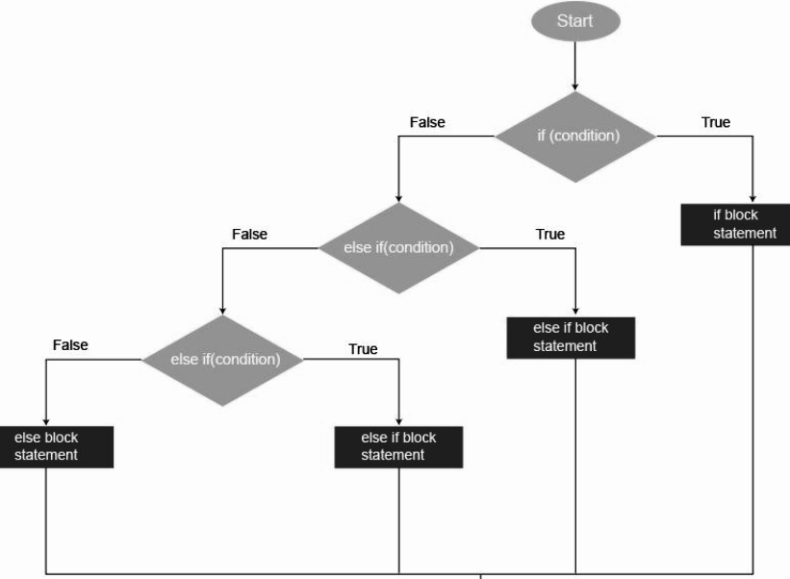
Types of Conditional Statements
Else If Statement
Else if Statement is used to make the correct decision out of several decisions.
JS Conditional Statements
Types of Conditional Statements
‘Switch’ Statement

Slide 4
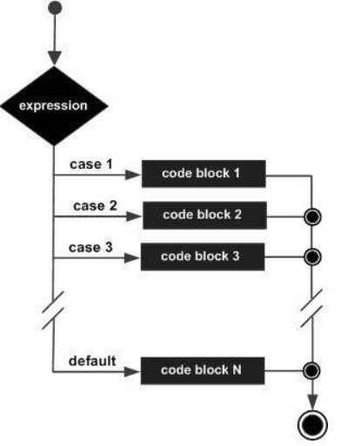
Switch Statement
To perform different actions based on different conditions we use switch statements.
Switch statement is more efficient than else if statement.
JS Conditional Statements
Types of Conditional Statements
‘Switch’ Statement

Slide 5
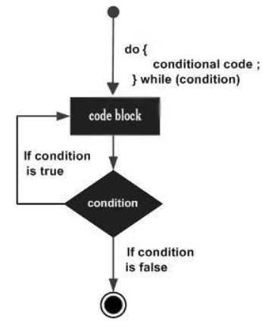
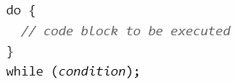
Do While Loop
The Do While Loop is an Exit controlled loop, i.e. the block condition is at the end of the loop.
The Do While Loop executes the loop statement before checking the condition.
Syntax
While Loop
While Loop Example
Do While Loop
Do While Loop Example
While VS Do While

Slide 6
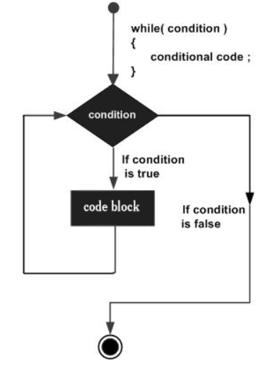

While Loop
The While Loop is a control flow statement used to execute the code repeatedly as long as the condition is true.
Syntax
While Loop
While Loop Example
Do While Loop
Do While Loop Example
While VS Do While

Slide 7
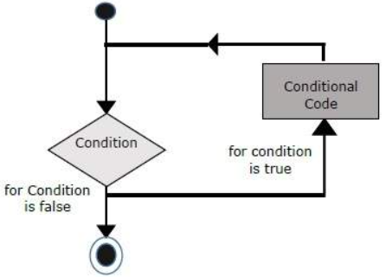
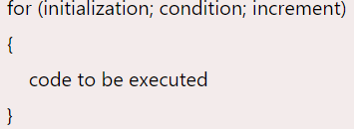
For Loop
The For Loop is used when the number of iterations is known.
Syntax
Initialization - Initialize the variable in use.
Condition - Exit condition is tested here. It returns a boolean value.
Condition is checked prior to the execution of the loop statement.
Code - If condition is true, then the Loop statement is executed.
Increment/
Decrement - Update values for next iteration.
JavaScript Loops
Types of Loops
For Loop
For In Loop
For Of Loop
Notes:
explain about the For Loop with help of the code: https://replit.com/@FathimaU/ForLoop?v=1#index.html.

